Slide 1
MANAGEMENT INFORMATION SYSTEMS
Chapter 4: Ethical and Social Issues in Information Systems

Slide 2
Recap of Chapter 3
What are the technical and behavioral views of organizations?
How do features of an organization affect information systems, and how do information systems affect organizations?
What is Porter’s Competitive Forces Model and the Value Chain Model?
Explain synergies, core competencies, and network economics.
How can AI be used in competitive strategies?
What are challenges posed by strategic information systems?

Slide 3
Ethics and Information Systems

Slide 4
Ethics and Information Systems
Ethics refer to the principles of right and wrong that individuals, acting as free moral agents, use to make choices to guide their behaviors.
Historically, major inventions have raised ethical challenges:
Printing Press: Democratized knowledge but raised concerns about censorship of radical ideas.
Industrial Revolution: Drove economic growth but raised concerns about worker exploitation.
Nuclear Technology: Provided a new source of energy but raised ethical debates about weaponization.
The advent of powerful information systems presents similar dilemmas:
IS enables businesses to operate more efficiently than ever.
IS disrupts existing distributions of power and accelerates social change.
Like past technologies, IS offer great benefits while raising profound ethical questions.

Slide 5
Ethics and Information Systems
Today’s IS-related ethical concerns include:
Internet and digital platforms
Artificial Intelligence and automation
Customer data use and privacy
Intellectual property protection
Key questions include:
How can we safeguard system quality to protect individuals and society?
How can we ensure accountability for IS consequences?
How can we preserve social values and institutions in the digital age?
Central Question: What is the ethical and socially responsible course of action?

Slide 6
Ethical Challenges in Conducting Business
Organizations face numerous ethical challenges in conducting business.
Recent years have seen high-profile failures in ethical judgment across many industries:
Fintech: Terra/Luna Collapse, FTX Collapse (2022)
Aviation: Boeing 737 Max Crisis (2019-2020)
Health: Theranos (2015-2022)
Automobile: Volkswagen’s “Dieselgate” (2015)
Failures in ethical business judgment are rarely masterminded by IS staff, but IS often enables misconduct:
IS can be used to conceal or disguise actions (Volkswagen, 2015)
IS can also help bury evidence from public scrutiny (Uber’s data breach cover-up, 2017)

Slide 7
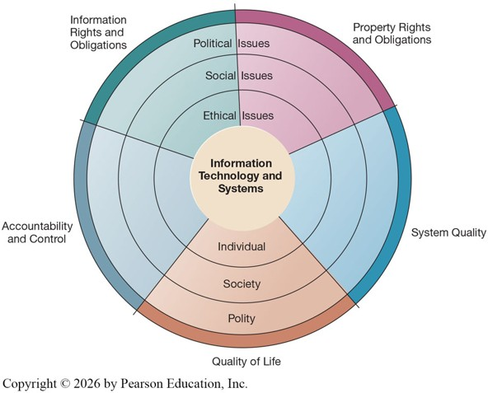
A Model for Ethical, Social, and Political Issues
Ethical, social, and political issues are closely linked, and ethical dilemmas in IS often become social and political debates.
Model:
Society can be thought of as a calm pond in equilibrium.
Social institutions (family, education, organizations) provide rules of behavior.
Political institutions (laws and sanctions) enforce rules and norms.

Slide 8
A Model for Ethical, Social, and Political Issues
New information technologies act as a shock to the system, similar to tossing a rock into a calm pond.
Consequences:
Old rules may not apply to new situations.
Social institutions take time to develop new norms.
Political institutions need time (and evidence of harm) to create new laws.
Managers and firms may need to act in areas of legal ambiguity.

Slide 9
“Rocks in a Pond”
Social Media Platforms
Individual: Impacts on mental health, identity, and self-expression.
Social: Transformed how news spreads; fueled rise of influencers and new cultural norms.
Political: Concerns about election interference, national security, and content moderation.
Facial Recognition Technology
Individual: Concerns about constant surveillance and loss of privacy.
Social: Debates about fairness, bias, and discrimination in AI systems.
Political: Some cities/states banning or restricting government use.
New technologies act as rocks in a pond:
Creating ripples at the individual, social, and political levels that often outpace existing rules.
These ripples often highlight recurring areas of ethical concern, which we can group into five moral dimensions.

Slide 10
Key IT Trends that Raise Ethical Issues
Ethical issues predate IT, but information technology has intensified these concerns.
Five major trends drive most of the ethical stress.
Increasing Computing Power:
Computing power is now central to core production processes.
Dependence on IS has grown, leading to increased vulnerability to errors and poor data quality.
Advances in Data Storage:
Falling storage costs enable massive data collection on individuals.
Routine violations of privacy are inexpensive and effective.

Slide 11
Key IT Trends that Raise Ethical Issues
Advances in Data Analysis:
Tools allow firms to combine and mine disparate data sources.
These tools enable profiling, including the assembly of digital dossiers on individuals.
Advances in Networking & Mobility:
Internet and mobile devices allow easy access to massive data pools.
Privacy invasion is possible on an unprecedented scale.
Artificial Intelligence:
Increasingly used to substitute for human judgment.
Ignores human empathy and moral reasoning.
Raises issues for privacy and intellectual property rights.

Slide 12
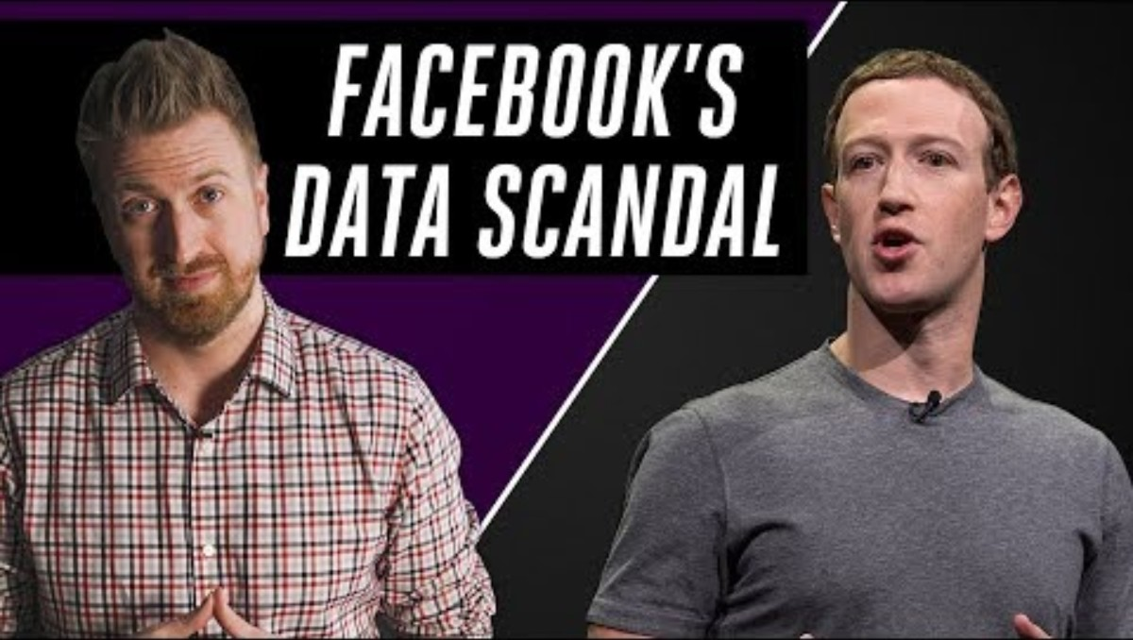
The Verge (2018, March 22). Facebook’s Cambridge Analytica data scandal, explained [Video]. YouTube. https://youtu.be/VDR8qGmyEQg?si=3Es4Xg8gXHEXxPwo

Slide 13
Cambridge Analytica Case
Advances in Data Storage:
Facebook stored vast amounts of user data, and Cambridge Analytica was able to exploit loopholes to collect information on tens of millions of users.
Cheap, large-scale storage makes mass data collection easy, and when mishandled, it can turn into a serious privacy violation.
Computing Power, Data Analysis, and Networking & Mobility:
Cambridge Analytica used psychographic profiling, analyzing likes and behaviors to infer political attitudes and target individuals with tailored messages.
The scandal spread globally because Facebook’s platform is interconnected and mobile-accessible, allowing microtargeted political ads to reach users across borders.

Slide 14
Obedience, Authority, and
Ethical Conduct

Slide 15

Obedience as a Virtue
Many unethical decisions occur within organizations.
Obedience is often viewed as a virtue:
Long regarded as a moral virtue linked to loyalty, discipline, and social stability.
Large organizations require compliance with rules and authority to function efficiently.
“Good” employees often:
Follow instructions from supervisors without question.
Assume leadership has validated the risks, diffusing responsibility upward.
When does obedience become complicity?

Slide 16

Obedience as a Virtue?
“The Banality of Evil” (1963)
From Eichmann in Jerusalem by Hannah Arendt.
Profound harm can result not from monstrous intent, but from ordinary individuals uncritically performing their assigned roles.
Great wrongdoing can be carried out by people who see themselves as merely “doing their job.”
Key Insight:
Ethical danger increases when individuals prioritize procedural compliance over moral reflection.
Individuals may view themselves as functionaries within a system rather than as responsible moral agents.

Slide 17
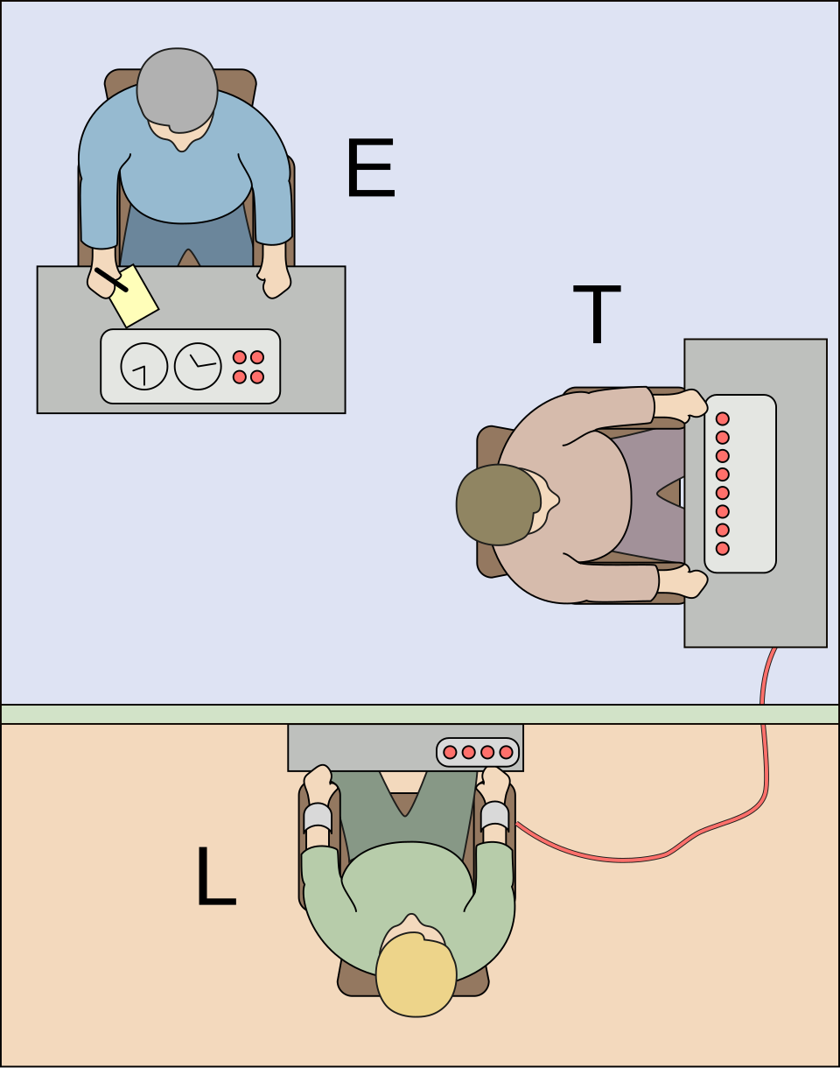
The Milgram Experiment (1961-1963)
Several hundred participants took part in a series of experiments on learning and memory.
Participants were randomly assigned to the role of “teacher (T)” or “learner (L).”
The teacher administered a word-association test to the learner.
For each incorrect answer, the teacher was instructed to administer an electric shock.
The shock intensity increased after each incorrect answer.

Slide 18
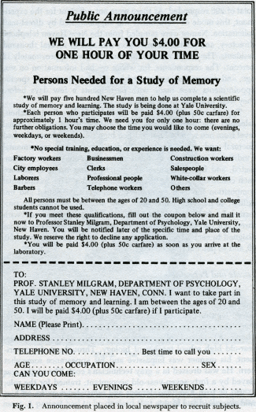
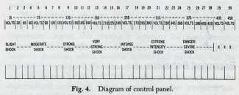
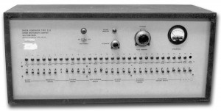
The “Actual” Milgram Experiment
The true focus of the experiment was obedience to authority.
Participants believed roles were randomly assigned:
All participants served as teachers.
The learners were actors.
The learner responded incorrectly according to a prearranged schedule, causing the shock intensity to steadily increase.

Slide 19
Obedience to Authority: The Milgram Experiment
If the teacher expresses hesitation, the experimenter (another actor) responds with scripted prompts:
“Please continue”
“The experiment requires that you continue”
“It is absolutely essential that you continue”
“You have no other choice, you must go on”
Results:
In the initial experiment, 26 of 40 participants continued administering shocks to the maximum level of 450 volts.
100% of participants continued to at least 300 volts.
Many participants showed visible distress (sweating, trembling, nervous laughter) yet still continued.
Authority pressure can override personal moral discomfort.

Slide 20
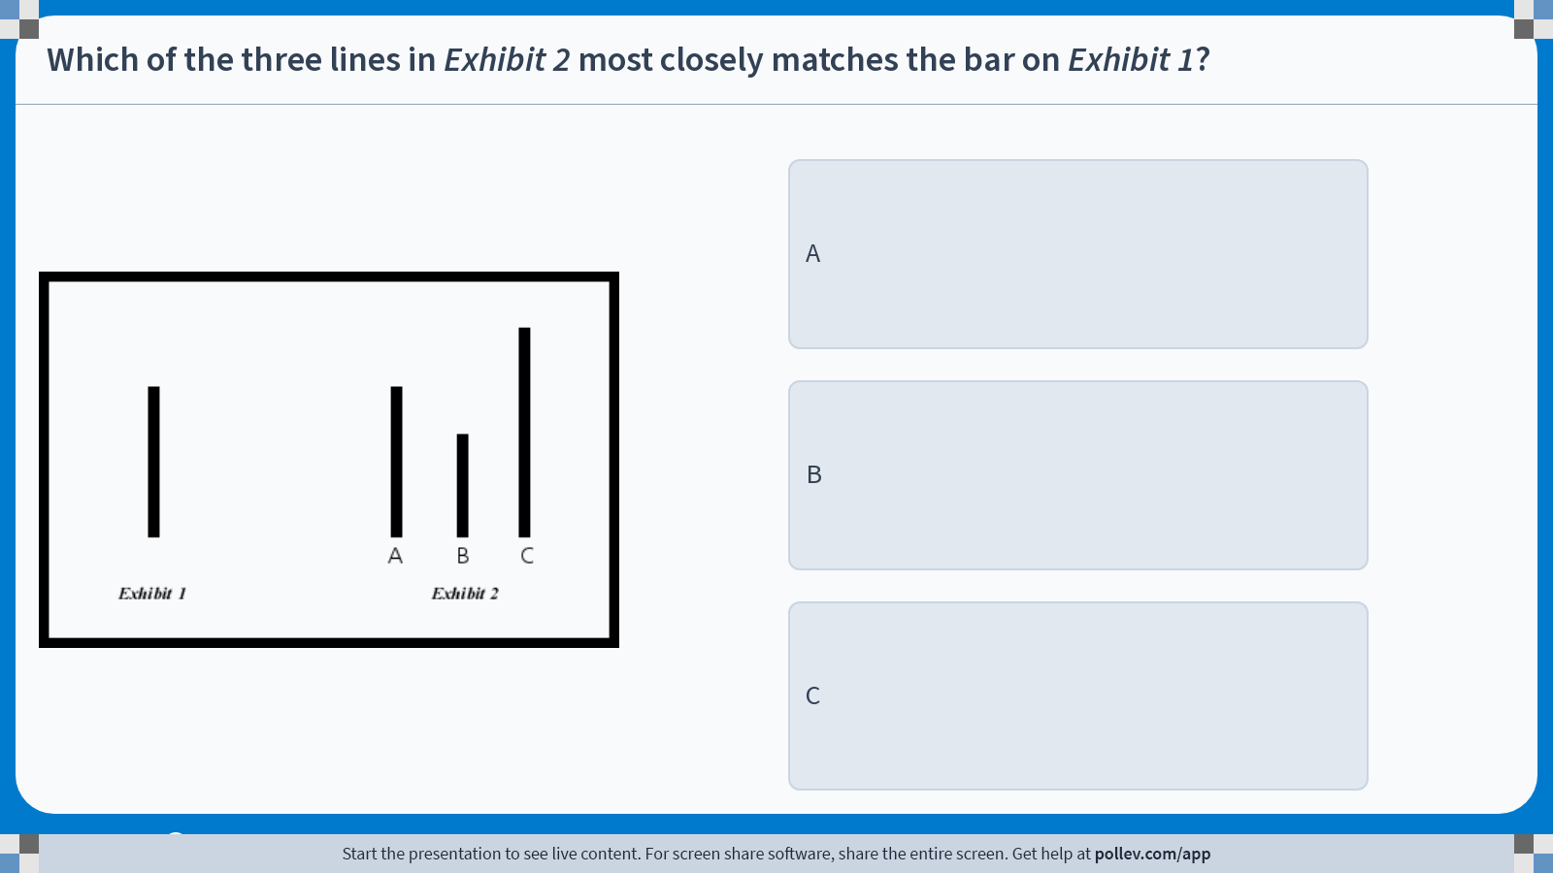
Poll Everywhere multiple choice poll instructions screen Activity Title: Which of the three lines in Exhibit 2 most closely matches the bar on Exhibit 1? Slide 20
Notes:
Do not modify the notes in this section to avoid tampering with the Poll Everywhere activity. More info at polleverywhere.com/support Which of the three lines in Exhibit 2 most closely matches the bar on Exhibit 1? https://www.polleverywhere.com/multiple_choice_polls/NGGP3KEeE7UPaO5vV6ogT?display_state=instructions&activity_state=opened&state=opened&flow=Engagement&onscreen=persist

Slide 21
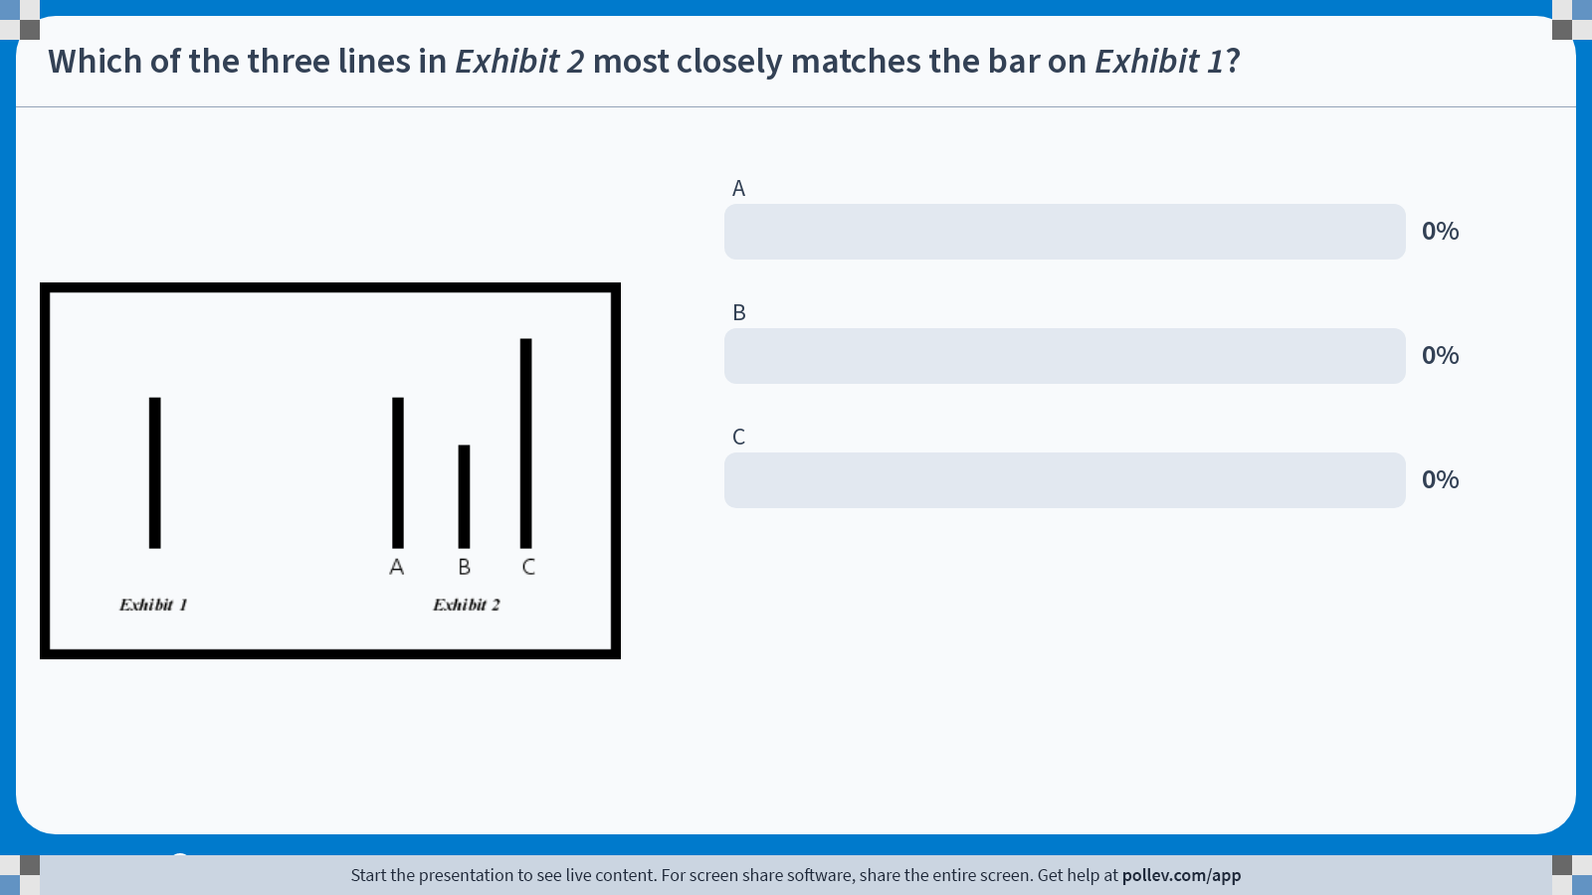
Poll Everywhere multiple choice poll chart screen Activity Title: Which of the three lines in Exhibit 2 most closely matches the bar on Exhibit 1? Slide 22
Notes:
Do not modify the notes in this section to avoid tampering with the Poll Everywhere activity. More info at polleverywhere.com/support Which of the three lines in Exhibit 2 most closely matches the bar on Exhibit 1? https://www.polleverywhere.com/multiple_choice_polls/NGGP3KEeE7UPaO5vV6ogT?display_state=chart&activity_state=closed&state=closed&flow=Engagement&onscreen=persist

Slide 22
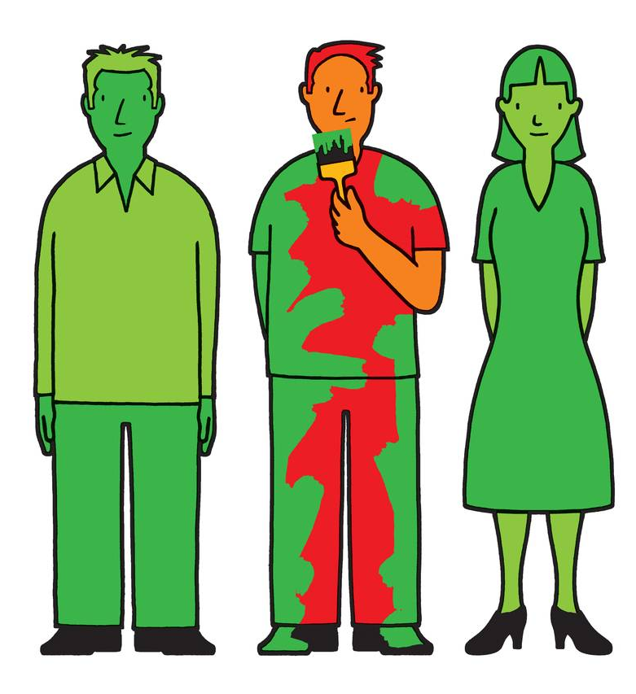
Asch’s Conformity Experiments
Participants were placed in groups where confederates intentionally gave incorrect answers.
Approximately 75% of participants conformed at least once to an obviously incorrect majority judgment.
On average, participants conformed on about 37% of the trials.
When even one other person gave the correct answer, conformity dropped dramatically.
Individuals often conform to group consensus even when they privately know it is wrong.
Even a single act of dissent can significantly reduce unethical conformity.

Slide 23
Principles for Ethical Conduct

Slide 24
Basic Concepts
Ethics is about individual choice: “When faced with alternatives, what is the correct moral action?”
Ethical analysis relies on Four Key Concepts:
Responsibility: Accepting potential costs, duties, and obligations for your decisions.
Accountability: Mechanisms exist to determine who acted and who is responsible.
Liability: Legal systems allow individuals to recover damages caused by others.
Due Process: Laws are known, understood, and fairly applied with the right to appeal.
Systems do not have impacts by themselves, but rather through the people who use them.
Users of IS can be held accountable for outcomes.
Others can seek legal remedies when harmed.
Explore the Moral Machine experiment: https://www.moralmachine.net/

Slide 25
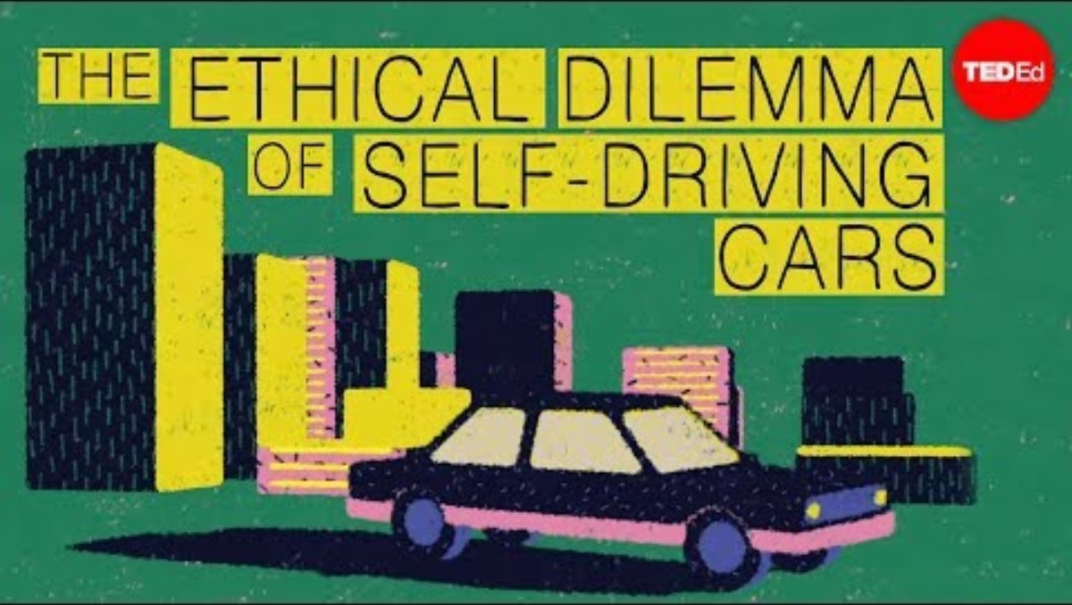
TED-Ed (2015, December 8). The ethical dilemma of self-driving cars – Patrick Lin [Video]. YouTube. https://youtu.be/ixIoDYVfKA0?si=SuJPlF1rE2aWaaOj

Slide 26
The Moral Machine Experiment
Self-driving cars highlight how emerging technologies challenge traditional concepts of responsibility, accountability, liability, and due process.
Responsibility: Accepting potential costs, duties, and obligations for your decisions.
Who is responsible for the car’s decisions? The passenger, the manufacturer, or the programmer?
Accountability: Mechanisms exist to determine who acted and who is responsible.
Systems must track and record decisions (e.g., sensor data, algorithms) to determine who acted.
Liability: Legal systems allow individuals to recover damages caused by others.
If harm occurs, who pays damages? The automaker, software developer, or human occupant?
Due Process: Laws are known, understood, and fairly applied with the right to appeal.
Legal systems must establish clear rules and allow appeals to ensure fairness.

Slide 27
Ethical Analysis: The Five-Step Process
Identify and describe the facts clearly.
Find out who did what to whom and where, when, and how.
Define the conflict or dilemma and the higher-order values involved.
What are the competing values? (e.g., Efficiency vs. Privacy)
Identify the stakeholders.
Who has a stake? What do they want?
Identify the options available.
What courses of action are realistic?
Identify the potential consequences of each option.
What happens short-term and long-term if you choose this option?

Slide 28
Ethical Analysis: Hypothetical Case-Study
Case:
A large retail company provides employees with wearable fitness trackers to encourage healthy habits. The company says the program is voluntary and offers discounts on health insurance premiums for employees who meet fitness goals. Later, employees discover that the company is also using this data to evaluate worker productivity and make decisions about promotions and scheduling.
Identify and describe the facts clearly.
Define the conflict or dilemma and the higher-order values involved.
Identify the stakeholders.
Identify the options available.
Identify the potential consequences of each option.

Slide 29
Ethical Analysis: Hypothetical Case-Study
Facts:
Company provides fitness trackers, claims voluntary use.
Data used for insurance discounts and performance evaluation.
Conflict/Dilemma:
Health promotion vs. employee privacy and autonomy.
Efficiency and profit vs. fairness and transparency.
Stakeholders:
Employees (privacy, fairness, career opportunities).
Employer/management (productivity, costs, reputation).
Insurance providers (risk reduction).
Customers/society (corporate responsibility).

Slide 30
Ethical Analysis: Hypothetical Case-Study
Options:
Continue current practice.
Use data only for health incentives, not productivity.
Make program fully transparent and opt-in with explicit consent.
Stop using trackers altogether.
Consequences:
Current practice: efficiency gains, but employee mistrust/ethical violations.
Health-only use: retains benefits, reduces ethical concerns.
Transparency/opt-in: builds trust, but may reduce participation.
End program: privacy preserved, but health incentives lost.

Slide 31
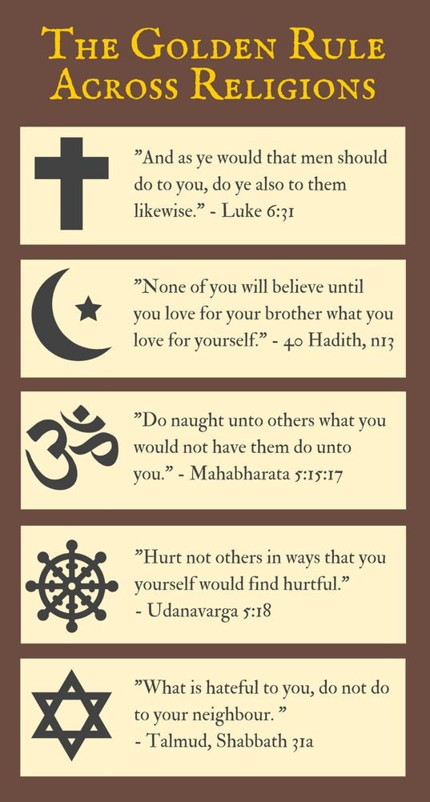
Ethical Principles: The Golden Rule
“Do unto others as you would have them do unto you.”
- Matthew 7:12
“Do not impose on others what you yourself do not desire.”
- The Analects 15:24
Historical Significance:
Appears independently across major religious and philosophical traditions.
Serves as one of the earliest and most intuitive ethical guidelines.
Core Idea:
Ethical behavior is grounded in empathy and perspective-taking.
Moral judgment begins by imagining oneself in the position of others.
Assumes shared human preferences and experiences.

Slide 32
Ethical Principles: The Golden Rule
Applying the Golden Rule reasoning requires managers to:
Consider how their decisions would feel if they were personally affected.
Reflect on the human impact of policies, not just legal or financial outcomes.
Key Strengths:
Intuitive and easy to apply in everyday decision-making.
Encourages empathy, trust, and respectful treatment.
Particularly useful in interpersonal and organizational contexts.
Key Limitations:
Assumes decision-makers’ preferences align with others’.
Provides little guidance when interests conflict.
Lacks clear rules for resolving large-scale or systemic tradeoffs.

Slide 33
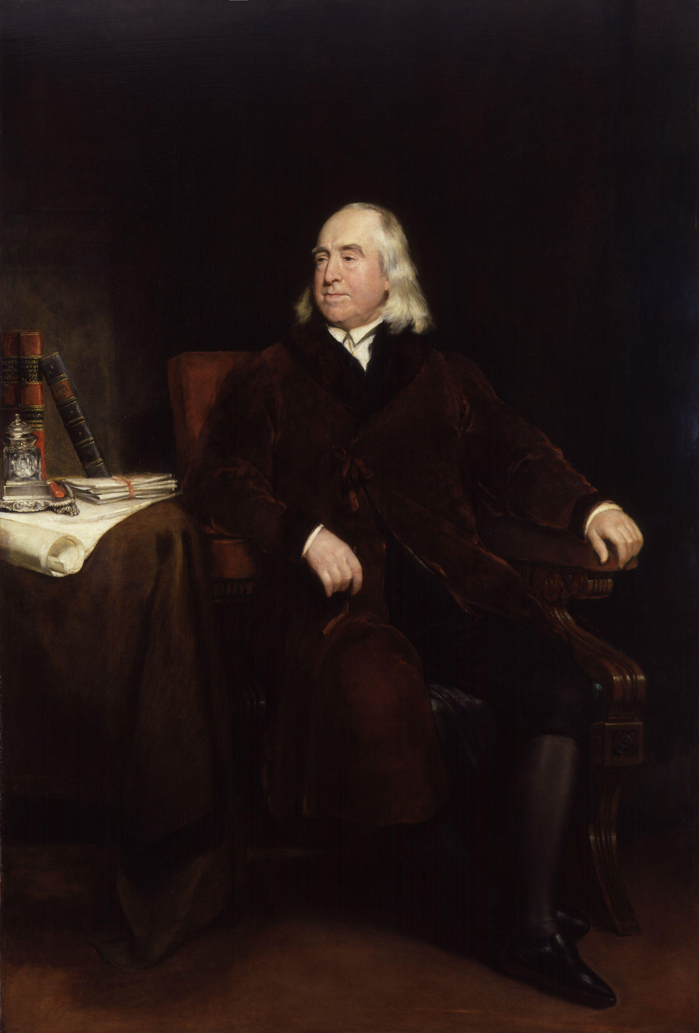
Ethical Principles: Utilitarianism
“It is the greatest happiness of the greatest number that is the measure of right and wrong.”
Historical Context (Late 18th century):
Moral and legal authority was traditionally grounded in religion, custom, and aristocratic privilege.
Laws often reflected the interests of elites rather than social welfare.
Bentham’s Core Idea:
Argued that pleasure and pain are universal human experiences that can serve as a foundation for ethics.
Proposed that moral and legal rules should be judged by their observable consequences.
Shifted moral authority away from tradition and toward outcomes.

Slide 34
Ethical Principles: Utilitarianism
Applying utilitarian reasoning requires managers to:
Identify all affected stakeholders, not just customers or shareholders.
Estimate benefits and harms across groups, even when outcomes are uneven.
Aggregate outcomes rather than focusing on individual rights or intentions.
Key Strengths:
Forces explicit tradeoff analysis.
Aligns naturally with cost-benefit analysis and efficiency metrics.
Commonly used in policy, regulation, and business decision-making.
Key Limitations:
Difficult to measure and compare “happiness” across individuals.
Can justify serious harm to minorities if aggregate benefits are large.
Often ignores fairness, rights, and consent.

Slide 35
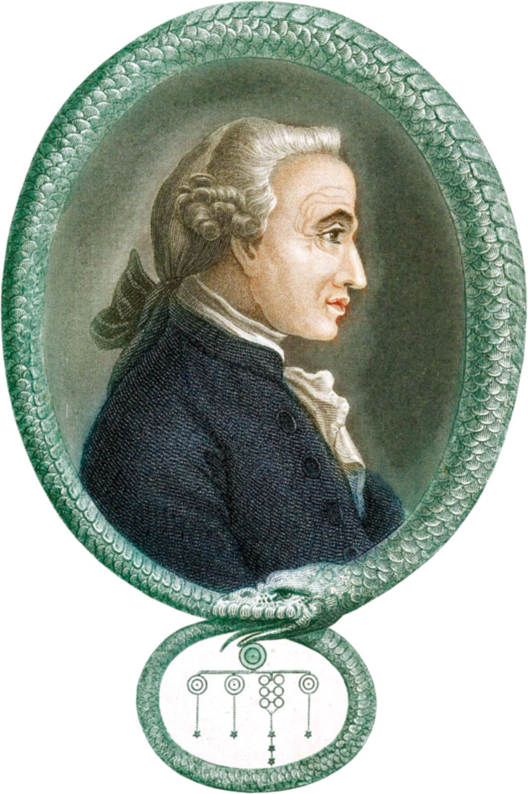
Ethical Principles: Deontology
“One should act only on maxims that they could rationally will to become a universal law for all people.”
Kant’s Core Idea:
Morality is based on rules and duties, not outcomes.
Actions are judged by whether they follow universal moral principles.
Moral rules must apply equally to all, regardless of personal benefit.
Hypothetical vs. Categorical Imperatives:
Hypothetical imperatives depend on desired outcomes.
“I must not lie, because I will be punished if caught.”
Categorical imperatives apply unconditionally.
“I must not lie. Period.”

Slide 36
Ethical Principles: Deontology
Applying Kantian reasoning requires managers to:
Ask whether a rule could be applied universally without contradiction.
Evaluate actions based on intent and principle, not consequences.
Treat individuals as ends in themselves, not merely as means to an objective.
Key Strengths:
Protects individual rights and human dignity.
Prevents harm being justified by efficiency or aggregate benefit.
Provides clear moral constraints in ambiguous situations.
Key Limitations:
Can ignore consequences, even when harm could be reduced.
May lead to rigid or impractical outcomes in real-world settings.
Difficult to apply when moral duties conflict.

Slide 37
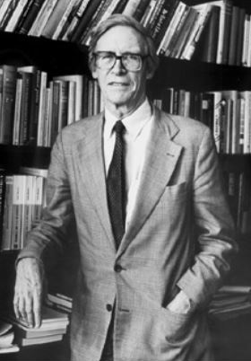
Ethical Principles: The Veil of Ignorance
“A just society is a society that if you knew everything about it, you’d be willing to enter it in a random place.”
Rawls’ Core Idea:
Principles should be chosen without knowing one’s position in society.
Fairness requires removing self-interest from moral and institutional design.
Ethical rules should protect individuals against worst-case outcomes.
Individuals design rules from the original position, behind a veil of ignorance, unaware of:
Their class or social status,
Their natural abilities or talents,
Their personal beliefs, preferences, or identity

Slide 38
Ethical Principles: The Veil of Ignorance
Applying Rawlsian reasoning requires managers to:
Evaluate decisions as if they did not know which stakeholder role they would occupy.
Focus on fairness of processes, not just outcomes.
Pay special attention to how policies affect the least advantaged groups.
Key Strengths:
Strongly protects fairness and equality of opportunity.
Avoids sacrificing minorities for aggregate benefits.
Useful for evaluating institutional rules, policies, and system design.
Key Limitations:
Can prioritize fairness over efficiency.
Offers limited guidance for short-term or individual decisions.
Difficult to apply when tradeoffs between groups are unavoidable.

Slide 39
Ethical Principles: Other Examples
Slippery Slope Rule:
If an action cannot be taken repeatedly, it should not be taken at all.
e.g., Allowing minor privacy intrusions could lead to widespread surveillance if repeated.
Risk Aversion Principle:
Take the action that produces the least harm or the least potential cost.
e.g., Choosing more secure but slower software updates to minimize the risk of catastrophic breaches.
No-Free-Lunch Rule:
Assume everything of value is owned by someone unless explicitly stated otherwise.
e.g., Using images, music, or software without proper licensing violates intellectual property rights.
As the appearance of unethical behavior itself can be damaging, managers must closely examine any actions that do not pass these ethical principles.

Slide 40
Professional Codes of Conduct / Ethics
Professionals have special rights and obligations due to specialized knowledge and public trust.
Professional associations often create Codes of Conduct:
To set entrance qualifications and measure competence.
To establish shared ethical standards.
To promote accountability and self-regulation.
Some professional organizations set a Code of Ethics.
In general, codes of conduct govern rules and behaviors in specific contexts.
Meanwhile, codes of ethics focus on the values and guiding ideals of professionals.
In practice, the lines are blurred and often used interchangeably.

Slide 41
Governance Codes
Beyond profession-wide codes of ethics, organizations also adopt governance codes to guide internal behavior.
Governance codes are internal frameworks of policies, guidelines, and technical guardrails.
Ensure consistent ethical decision-making and align with values, compliance, and risk management.
Example: Accenture’s Responsible AI Program
Accenture has implemented a Responsible AI program to operationalize ethics.
Based on core principles of “Human by design”, Fairness, Transparency, Safety, Accountability, Compliance, Sustainability.
Example: Responsible AI Institute
Responsible AI Institute offers “Industry-agnostic, plug-and-play” policy templates.
Major players such as AWS, BCG, ATB Financial, Shell are members.

Slide 42
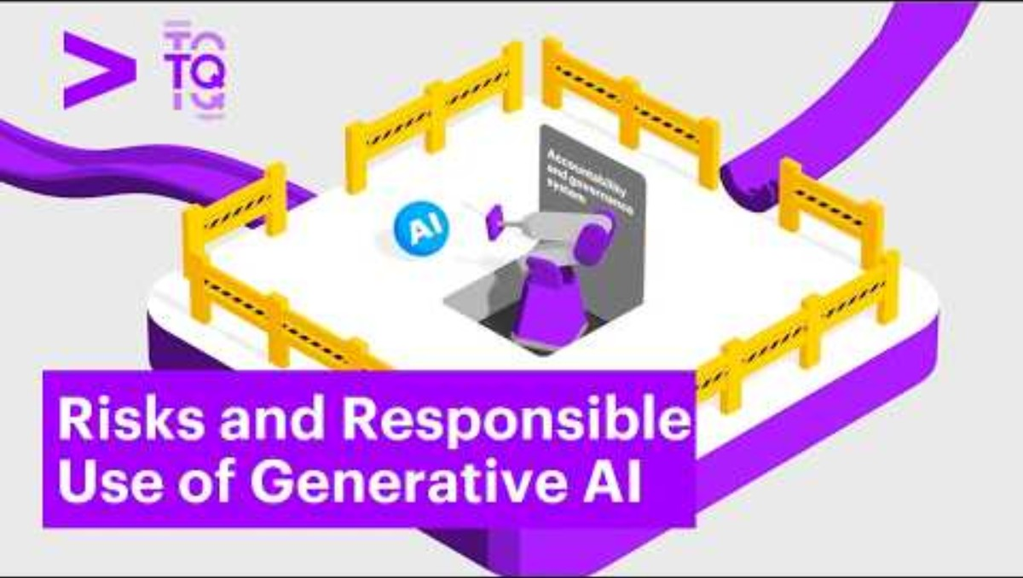
Accenture (2025, March 28). Risks and Responsible Use of Generative AI [Video]. YouTube. https://youtu.be/-n1eQXLZnXc?si=Mrml5p76V6z7izyl

Slide 43
Information Rights

Slide 44
Information Rights in the Digital Age
In the digital era, ethical dilemmas often center on the collection and use of personal information.
Information Rights refer to the rights that individuals and organizations have regarding information that pertains to them personally.
Privacy is the claim to be left alone, free from surveillance or interference by others, including employers and the state.
Advances in IT have made it cheap, profitable, and highly effective to invade individual privacy.

Slide 45
Legal Protections in the U.S.
In the U.S., privacy protections come from constitutional amendments:
First Amendment: Protects freedom of speech and association.
Fourth Amendment: Guards against unreasonable search and seizure.
Fifth and Fourteenth Amendments: Ensure due process when personal data is involved.
Federal laws also guarantee privacy protection:
Privacy Act (1974): Lets people see, correct, and limit how federal agencies use their personal data.
HIPAA: Protects medical records; gives patients privacy and access rights.
Gramm-Leach-Bliley (1999): Requires banks to safeguard financial data and explain sharing practices.
…and much more (see Table 4.3)
U.S. privacy law is piecemeal and sector-specific, not a single unified framework, so to fill these gaps, a broader set of guiding principles was developed.

Slide 46
Legal Protections in the EU
The EU’s General Data Protection Regulation (GDPR) is the most comprehensive privacy law to date.
It applies worldwide to any organization that processes the personal data of EU citizens, regardless of location.
GDPR strengthens individual rights by guaranteeing access to personal information, the right to be forgotten, and the right to data portability.
Organizations must gain explicit opt-in consent, appoint data protection officers, and report breaches within 72 hours.
Penalties can reach $20 million or 4% of global revenue, making GDPR a powerful enforcement tool.

Slide 47

Parks and Recreation (2017, November 2). Parks and Recreation | Ron vs. Online Privacy (Episode Highlight) [Video]. YouTube https://youtu.be/8xn1rO1oQmk?si=aIG2hKThMKFYd15F

Slide 48
Challenges Posed by the Internet
But even with laws in place, the Internet itself creates major privacy challenges.
The Internet enables companies to track users’ searches, browsing history, purchases, and mobile app usage.
Cookies are one of the most common tools:
First-party cookies enhance the user experience
Third-party cookies track users across multiple sites for advertising purposes.
Web beacons, spyware, and adware extend surveillance by collecting detailed data.
Companies argue that such tracking enables free content and more relevant advertising, but public surveys show widespread distrust and a sense of lost control.

Slide 49
Challenges Posed by AI
Artificial intelligence magnifies existing privacy concerns by requiring massive datasets for training and decision-making.
Tech companies have been accused of scraping personal data from the Internet without user consent to train generative AI models.
Industries such as healthcare and finance face added risks when sensitive data is used in AI systems.
Facial recognition databases, often built without consent, have sparked lawsuits under state biometric privacy laws.
Can technology itself help restore privacy, or must we rely on law and ethics?

Slide 50
Technological Solutions
Privacy-enhancing technologies (PETs) aim to give users more control over their data.
e.g., Encryption, VPNs, ad blockers, cookie controls, and browser privacy settings.
Many firms now offer privacy dashboards and consent managers to increase transparency.
However, most tools require users to take proactive steps, and they do not provide complete protection.
Effective privacy protection requires a combination of technology, law, and ethical organizational practices.
Privacy challenges remind us why information rights are a central moral dimension of the Information Age.

Slide 51
Intellectual Property Rights

Slide 52

Intellectual Property in the Digital Age
Intellectual Property (IP) refers to products of the mind, such as ideas, inventions, and creative works.
Modern information technology makes IP protection more difficult because digital content can be copied, transmitted, and altered with ease.
It is traditionally protected through four legal traditions:
Copyright
Patents
Trademarks
Trade Secrets

Slide 53
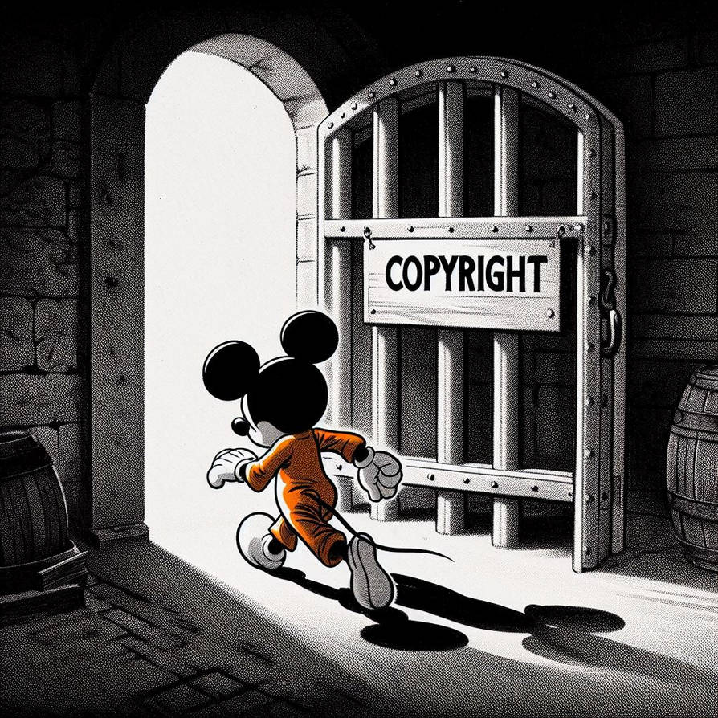
IP: Copyright
Copyright protects the creators of literary, artistic, musical, and software works.
Protection generally lasts for the life of the author plus 70 years, or 95 years for corporate works.
Copyright protects the expression of ideas, not the ideas themselves.
Ethical tension:
How long should creators control cultural works?
When does protection become restriction?
Example: Steamboat Willie (1928)

Slide 54
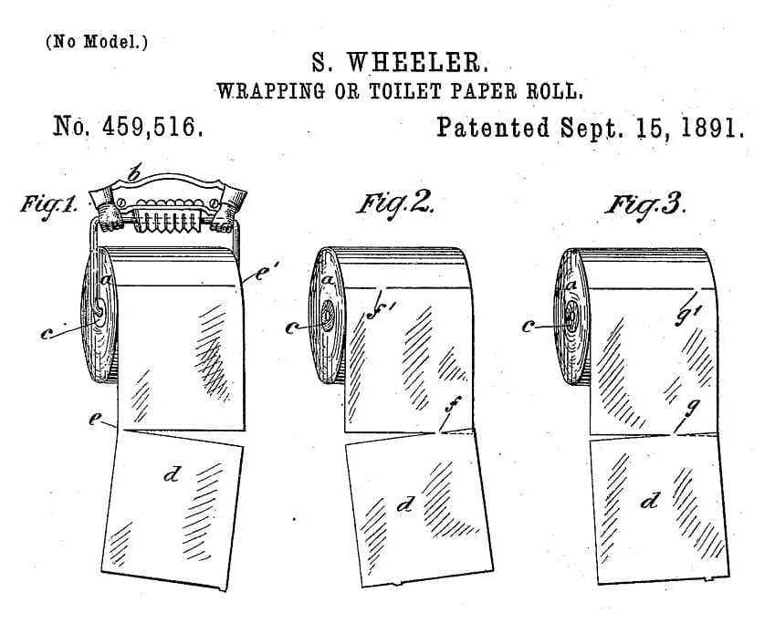
IP: Patent
A patent grants the inventor exclusive rights to make, use, or sell an invention for approximately 20 years.
To qualify, an invention must demonstrate novelty, non-obviousness, and usefulness.
Patents protect functional inventions, not merely their expression.
Ethical tension:
Do patents promote innovation or restrict access?
How long should exclusivity last in fast-moving technology markets?

Slide 55
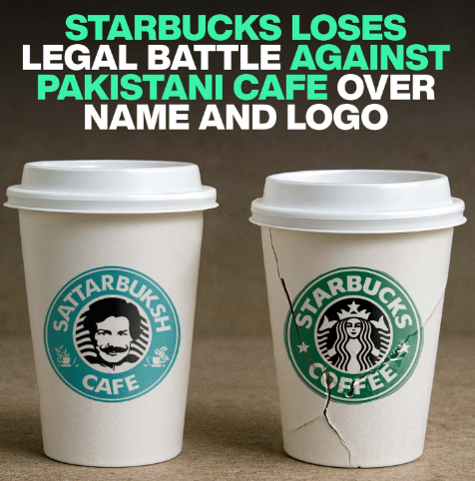
IP: Trademarks
Trademarks protect distinctive names, logos, symbols, and trade dress used to identify goods or services.
Trademark law focuses on preventing consumer confusion about the source of a product.
Protection can last indefinitely, as long as the mark remains in use and is defended.
Ethical tension:
When does brand protection become overreach?
Should global firms control similar local names across all markets?
Example: Sattar Buksh Café

Slide 56

IP: Trade Secrets
Trade secrets include formulas, processes, methods, devices, or compilations of data that provide value from not being publicly known.
Protection depends on maintaining secrecy through nondisclosure agreements, restricted access, and security practices.
Unlike patents, trade secrets do not require public disclosure and can last indefinitely.
However, once the information becomes public, protection is lost.
Example: Coca-Cola’s Recipe

Slide 57
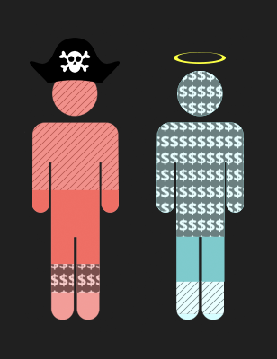
Challenges of Digital Networks
Digital media can be copied, transmitted, and altered with almost no cost or effort.
The Internet has made piracy widespread, with approximately 230 billion visits to piracy websites in 2023, an increase of 6.7 percent from 2022.
Early peer-to-peer platforms such as Napster, Grokster, and Kazaa disrupted the music and film industries by enabling large-scale unauthorized file sharing.
Legal and technical responses such as the DMCA, iTunes, and streaming platforms like Spotify have reduced piracy but have not eliminated it.

Slide 58

avril134 (2006, May 4). Piracy. It’s a Crime [Video]. YouTube. https://youtu.be/K_vHwfDNGdg?si=aIiSKBxvEFgJTh8H

Slide 59
AI and Intellectual Property
AI has raised copyright concerns because companies such as OpenAI, Microsoft, and Meta have trained models on copyrighted works without permission.
Patent law now allows inventions created with AI assistance, but only if humans make a significant contribution.
AI-generated outputs may resemble existing logos or designs, which can create trademark disputes and consumer confusion.
Trade secrets are at risk because employees sometimes share sensitive company data with public AI tools, while firms themselves increasingly hide algorithms as proprietary “black boxes.”

Slide 60
System Quality

Slide 61
System Quality Issues
In earlier sections we examined information rights and property rights, and now we turn to system quality, accountability, and quality of life as key moral dimensions.
Because businesses and society depend on reliable information systems, we must ask: what level of system quality is acceptable?
System failures raise ethical questions about accountability, liability, and responsibility when harm occurs.
Example: AWS Outage of 2025
These failures disrupted many everyday functions (public transit, healthcare, banking, etc.) of society.
Such outages highlight society’s growing dependence on a small group of cloud providers.
These cases raise the question of whether such disruptions should be considered acceptable risks or unacceptable failures of system quality.

Slide 62
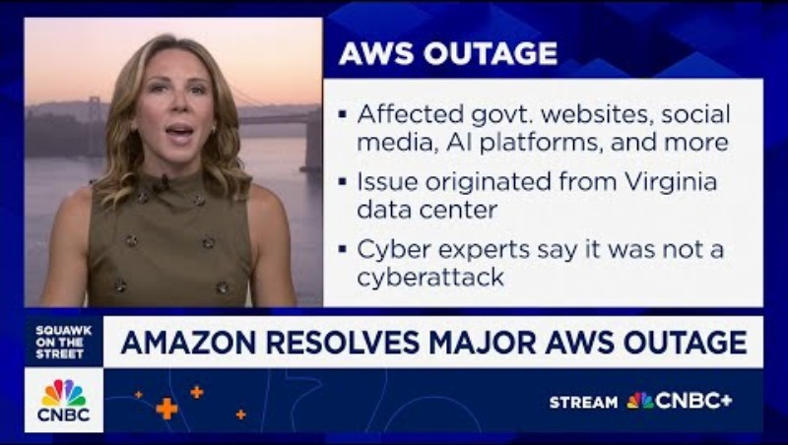
CNBC Television (2025, October 20). AWS outage knocks major AI and crypto providers offline, underscores fragility of cloud backbone [Video]. YouTube. https://youtu.be/_t64RLrjWOM?si=S0AdNQbZKJD854a8

Slide 63
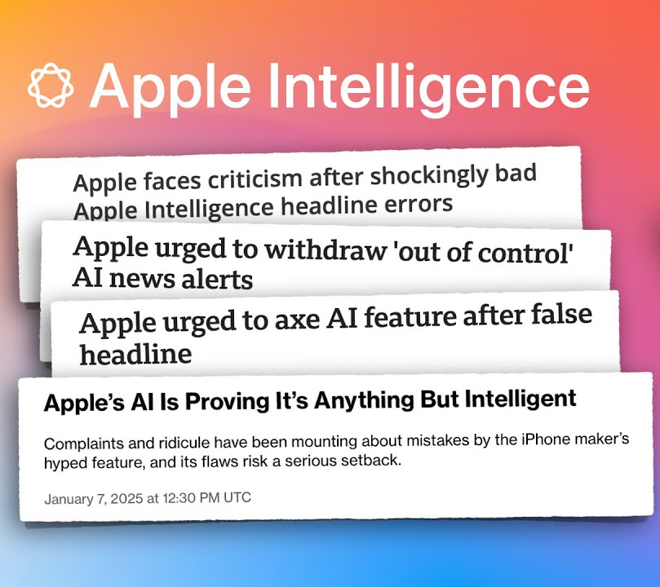
The Debate on “Acceptable” Quality
Managers must balance cost, time, and feasibility when deciding to release software.
Firms knowingly release products with bugs because fixing every error would make products too expensive or delay them indefinitely.
The Ethical Dilemma: Should companies delay, withdraw, or ship imperfect products knowing the risks?
Example: Apple Intelligence Rollout (2024)
Apple outsourced many generative AI functions to ChatGPT because its own system wasn’t ready.

Slide 64
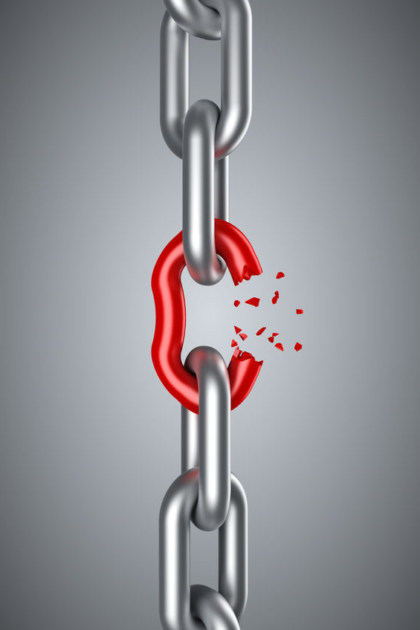
Three Major Sources of Failure
What responsibilities do managers bear when perfection is technologically impossible?
Perfection is not attainable due to three major reasons:
Software Bugs and Errors: Inevitable given software complexity.
Hardware or Facility Failures: Often caused by natural disasters or technical breakdowns.
Poor Input Data Quality: The most common and persistent source of business system problems.
Among these causes, poor data quality deserves special attention, since it quietly undermines performance more often than catastrophic failures.

Slide 65
Accountability and Control

Slide 66
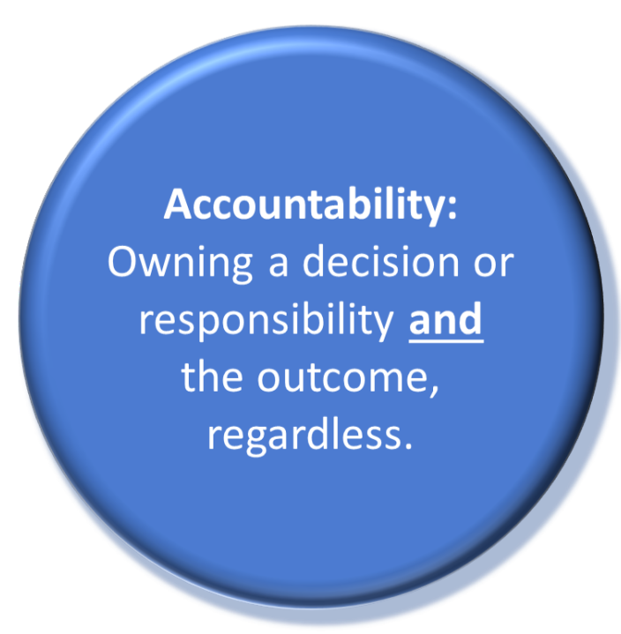
Accountability
The use of information technology sometimes results in harm, raising the question of who should be held accountable.
Accountability refers to identifying who is responsible for harm caused by defective or misused systems.
Ties directly to our discussion of system quality:
If perfection is impossible, then responsibility for harm becomes even more important.
Poorly designed or unpatched software can cause significant harm:
Reports suggest that up to 60% of breaches stem from unpatched vulnerabilities.

Slide 67
Software and Internet Liability Issues
Unlike physical goods, software is often not legally treated as a “product,” making liability claims difficult to pursue.
Vendors often use end-user license agreements (EULAs) to shield themselves from liability, leaving users with little legal recourse.
These challenges become even more complex with AI systems, where decision-making is often opaque or non-transparent.
AI often functions as a “black box,” making it hard to assign responsibility when harm occurs.
The EU AI Act (2024) and the revised EU Product Liability Directive expand legal accountability for AI providers, treating certain AI systems more like regulated products.
This framework shifts more of the burden of proof toward companies, protecting consumers when AI systems are too complex to audit.

Slide 68
Quality of Life

Slide 69

Quality of Life Issues
Beyond rights, property, and accountability, IS also affect the overall quality of life.
These effects may not always violate individual rights, but they can undermine culture, society, and personal well-being.
The key question is: “If both benefits and harms exist, who is responsible for the negative consequences?”
We begin with the growing concentration of economic and political power in Big Tech.

Slide 70
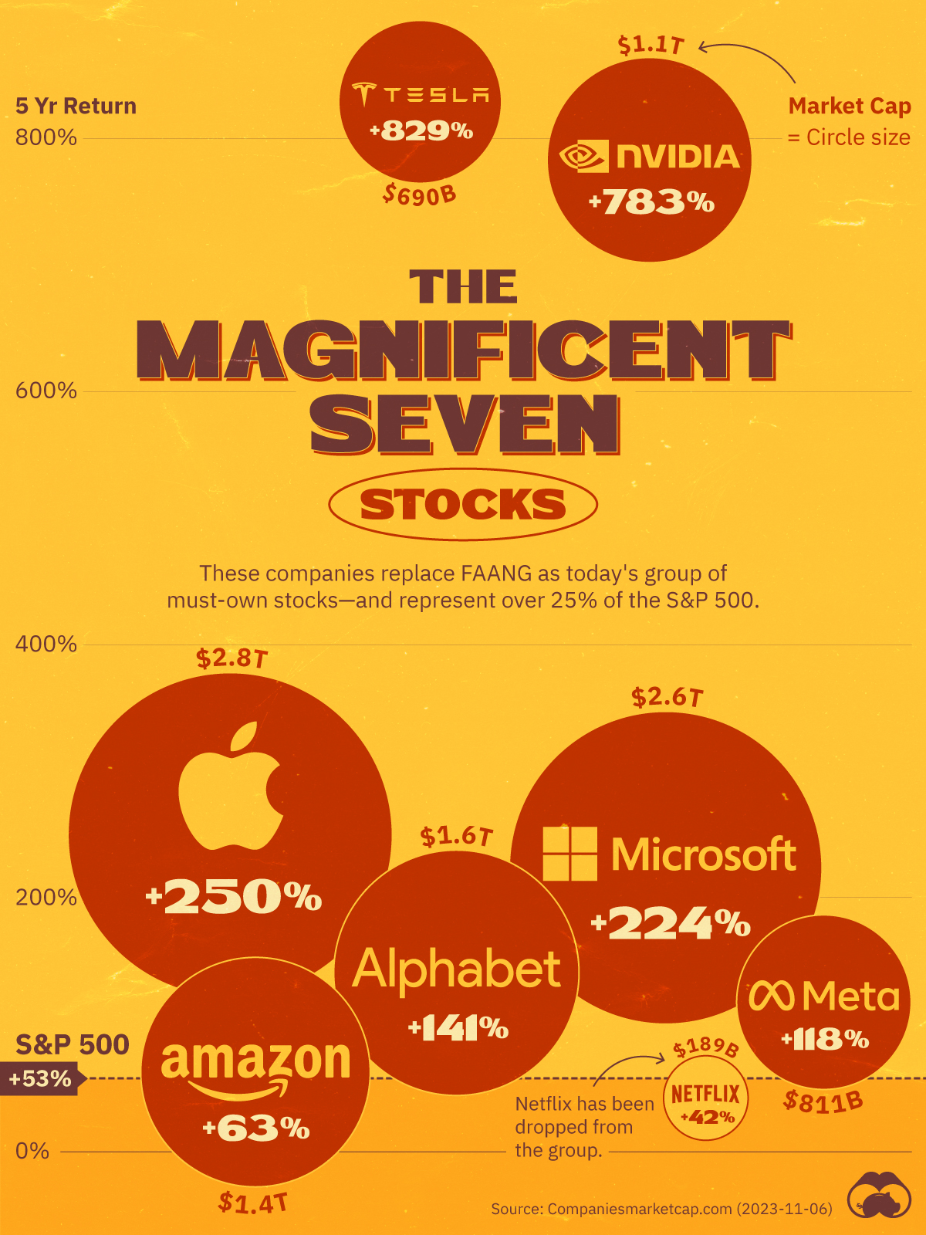
Big Tech: Concentrating Power
A small number of firms dominate key digital markets, and that dominance translates into political influence.
Antitrust enforcement is reemerging:
In 2024, a U.S. federal court ruled that Google illegally maintained monopoly power in Internet search.
Europe’s Digital Markets Act (DMA, 2024) seeks to limit the power of designated “gatekeepers” across digital platforms.
Concentration of power contributes to inequality at the market level.
Similar inequalities emerge at the individual level through the digital divide.

Slide 71

National Geographic (2017, September 24). The Digital Divide in America | American High School [Video]. YouTube. https://youtu.be/TyOQLGRyKt4?si=Iv-DXqTsobdvhsdg

Slide 72

The Digital Divide
Access to computers, the internet, and digital skills remains uneven across income, racial, and geographic lines, causing a digital divide.
Higher-income children are more likely to use the internet for educational purposes, while lower-income children are more likely to use it primarily for entertainment.
Left unaddressed, the digital divide could create a society of “information haves” and “have-nots.”
AI systems may reinforce inequalities when trained on biased data, leading to discrimination in policing, lending, and hiring.
Inequality also emerges in labor markets as automation and AI reshape employment opportunities.

Slide 73
Jobs and Automation
Information systems and automation have displaced millions of jobs, even while creating new opportunities.
AI is expected to reduce hiring in roles such as customer service while increasing demand in technical and high-growth industries.
Economists disagree on whether technology will ultimately create more jobs than it destroys.
The impact of AI on the workforce is uncertain, but its influence is undeniable.
Rapid change in markets and work pressures organizations and individuals to adapt quickly.

Slide 74
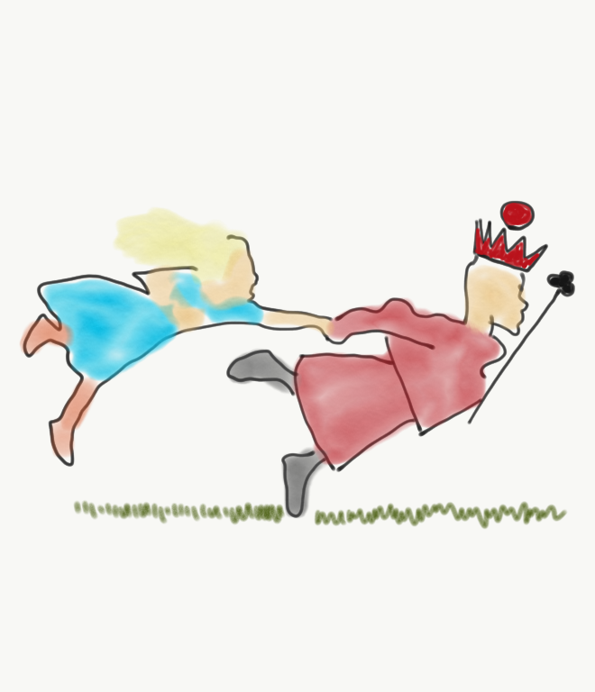
Pace of Change
“It takes all the running you can do, to keep in the same place.”
— Lewis Carroll
Global competition and digital markets have reduced the time available for firms to adjust.
Just-in-time economies can produce just-in-time jobs, workplaces, and even families.
Gig economy platforms such as Uber provide flexible work but often lack benefits and long-term security.
Beyond jobs and markets, quality of life is also shaped by blurred boundaries between work, family, and leisure.

Slide 75
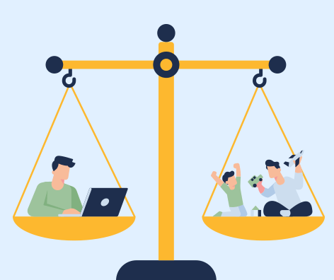
Maintaining Boundaries
Remote work, mobile computing, and “always-on” devices blur the lines between work and personal life.
Work increasingly encroaches on family time, leisure, and private reflection.
Social media and mobile apps can strain or disrupt relationships.
These social stresses are compounded by physical, mental, and cognitive health effects.

Slide 76
Health Risks
Physical Risks:
Repetitive Stress Injury (RSI), carpal tunnel syndrome, back and neck pain, and Computer Vision Syndrome (CVS).
Mental Health Concerns:
Screen time, online comparisons, cyberbullying, and social media addiction.
Cognitive Concerns:
Heavy reliance on search engines and AI tools may reduce opportunities for deep thinking and sustained problem solving.
As technology expands into AI, immersive platforms, and always-connected environments, these quality-of-life challenges may become more widespread and complex.

Slide 77
Recap of Chapter 4

Slide 78
Recap of Chapter 4
Describe IT/IS-related ethical, social, and political issues.
Describe principles for ethical conduct.
Discuss information rights and privacy issues.
Discuss intellectual property issues.
Discuss system quality issues.
Discuss accountability and control issues.
Discuss quality of life issues.

